Slide 1
TLPGNN: A Lightweight Two-Level Parallelism Paradigm for Graph Neural Network Computation on GPU
Presented By -
Ampolu Sahithi (12040130)
Chandramalika Ravipati (12041210)
Athulitha Yashaswini (12040610)

Slide 2
Introduction
GNNs are powerful for deep learning on graph-structured data.
Existing GNN computation frameworks have limitations in efficiency.
TLPGNN is a novel two-level parallelism paradigm to address these limitations.
This research aims to reproduce and extend the TLPGNN approach for optimizing GNNs on GPUs.
We implemented the TLPGNN approach with shared memory and Unified Memory for speedup.

Slide 3
Approach
TLPGNN addresses inefficiency of running GNNs on GPUs.
It utilizes two-level parallelism (vertex and feature parallelism) and workload assignment techniques.
This research focuses on implementing the code and comparing performance with shared memory and unified memory.
Deviations from original work:
Removed PyTorch dependency for code flexibility.
Explored shared memory for loading vertex feature vectors.
Used Unified Memory for feature matrix storage.

Slide 4
Evaluation Methodology
Hardware Platform: Google Colab with Tesla T4 GPU.
Datasets: Citeseer and Cora (benchmark datasets for GNN evaluation).
Baseline Comparison:
Results from the TLPGNN paper.
Implemented sequential and parallel code for comparison.
Metrics:
Execution Time
Memory Usage
Speedup

Slide 5

Results
Table showing results from the TLPGNN paper.
Table showing execution time and speedup for:
Sequential version
Parallel version
Parallel with shared memory
Parallel with unified memory access

Slide 6
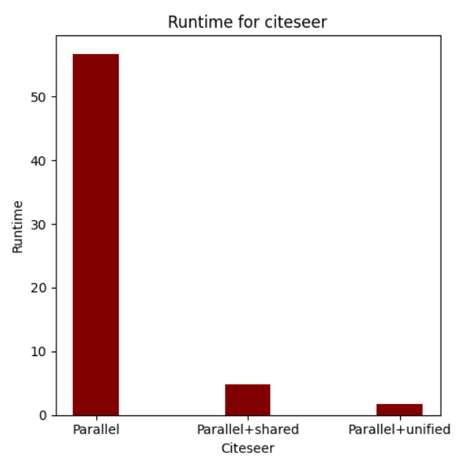
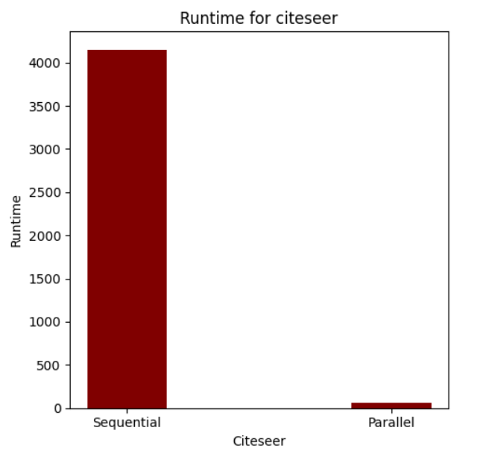
Citeseer bar graph comparison

Slide 7
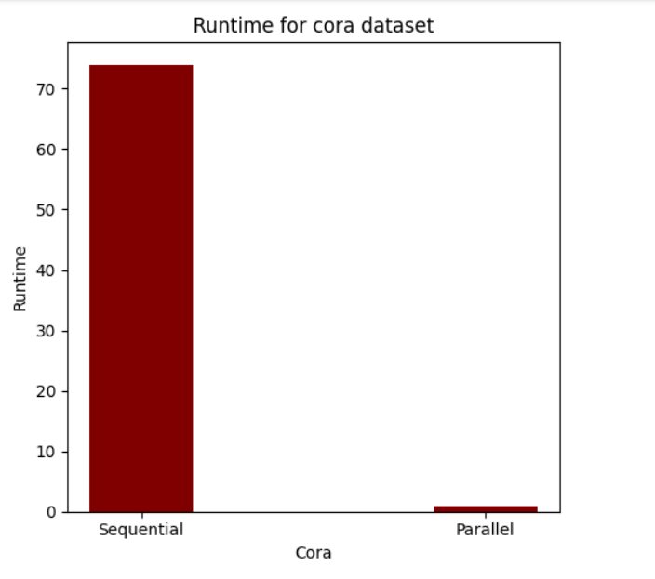
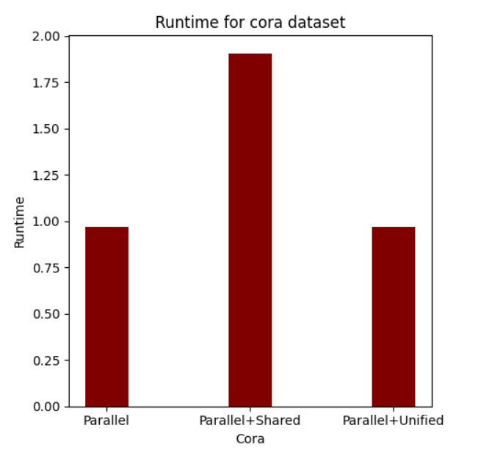
Performance Comparison for cora dataset

Slide 8
Conclusion
This research implemented the TLPGNN approach with shared memory and unified memory optimizations.
Significant speedup was achieved compared to the sequential version.
Further exploration of optimization techniques is possible.

